Slide 1


OLIST E-COMMERCE STORE ANALYTICS

Slide 2

AGENDA
Overview of E-commerce store
About Project
Dataset Understanding
Tableau Implementation
Key Performance Indicator(KPI) Understanding
Business Insights and Recommendations

Slide 3
OLIST
E-COMMERCE STORE
Company Name : Olist Store
Company Type : E-Commerce
Founder : Tiago Dalvi
Year Founded : 2015
HeadquaRter : Curitiba, Parana, Brazil
Employee Size : 1,001-5,000
Business Valuation : $ 1.5B (as of Dec 2021)
Olist operates an online e-commerce site for sellers, that connects merchants and their products to the main marketplaces of Brazil.
3

Slide 4
OBJECTIVE
Provide a platform to gain actionable insights into sales performance, customer behavior, and inventory management to optimize decision-making and drive business growth.
Empower decision-makers with easily accessible, visually appealing insights to support strategic and tactical decisions.
Utilize historical and current sales data to enhance forecasting accuracy, set realistic sales targets, and align the sales team's efforts with the company's strategic objectives.

Slide 5
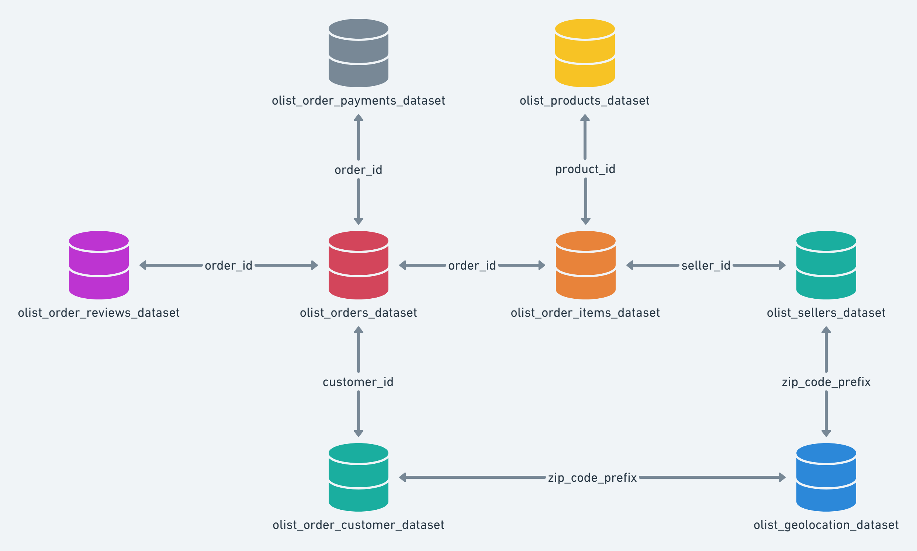
DATASET UNDERSTANDING
Dataset Type | CSV File
Record Types
String
Timestamp
Currency
Quantity
Geo Coordinates

Slide 6
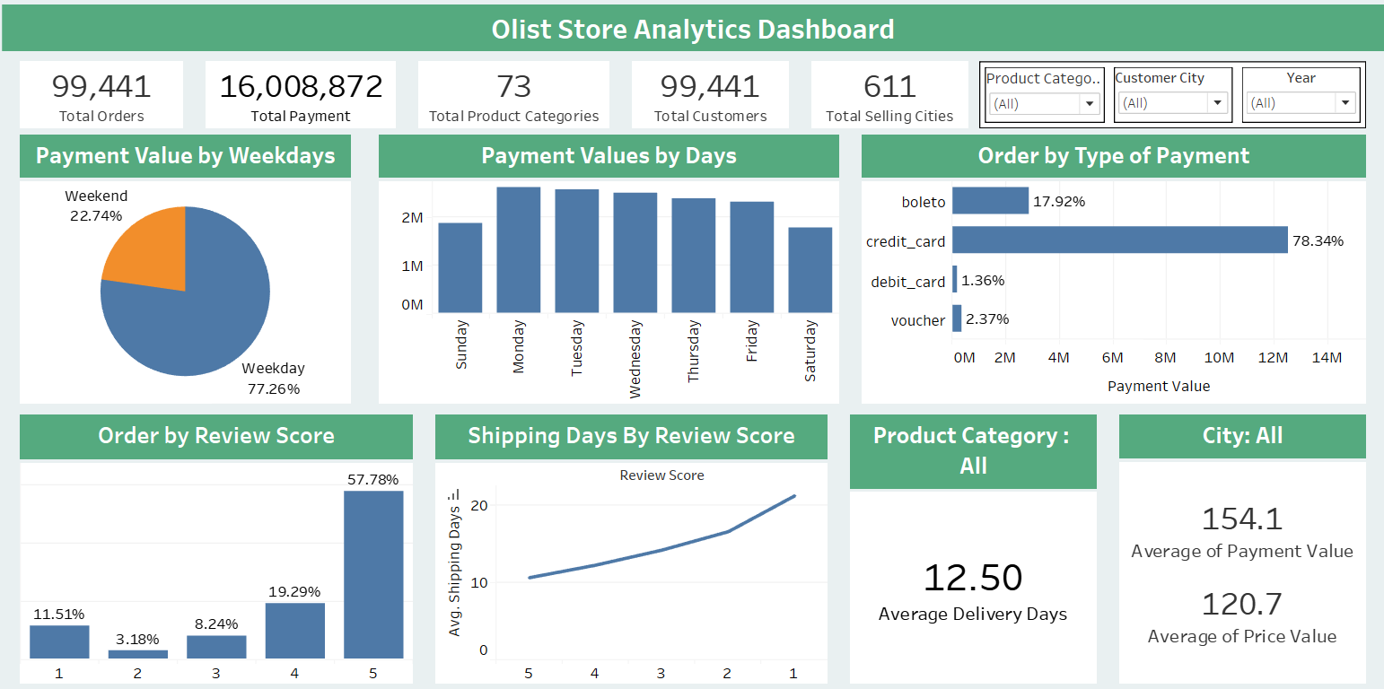
TABLEAU IMPLEMENTATION

Slide 7





SALES AND CUSTOMER DATA OVERVIEW
Total orders
99,224
Total Payments
14M
Total Products
73
Total Customers
96,476
Total selling cities
611

Slide 8
KPI 1: Weekday Vs Weekend Payment Statistics
The pie chart shows that the majority of payments (77%) are made on weekdays .
This suggests that people are more likely to shop or pay for services on weekdays than on weekends

Slide 9
KPI 2: Day wise Payment Statistics
The bar chart shows details of each day payment statistics.
This suggests that people are more likely to shop or pay for services on weekdays than on weekends.
The highest payments of the week occurred on Tuesday with 366.38k and Thursday with 349.4k.
The lowest payments were on the weekend, with Sunday at 269k and Saturday at 229k.

Slide 10




KPI 3: Number of Orders and payment type
Boleto is the second most popular payment, This boleto made around 18 % of orders.
Other payment methods, such as Voucher and Debit card are less popular forms of payment.
Credit card is the most popular payment method, the payment type credit card made around 78% of orders.

Slide 11
KPI 4: Average number of days taken for order delivered customer date for pet shop
11.31 is the average days taken to deliver the order for pet shop.
However for all categories, Average delivery days is 12.50 days.
This KPI analyzes the average number of days taken for order delivered customer date for pet shop.
It helps olist in identifying areas where they can improve their delivery time and maintain customer satisfaction.

Slide 12
KPI 5: Average price and payment values from customers of sao paulo city
Average of payment value and Average of Price by Sao Paulo City
The analysis of average price and payment values from customers of Sao Paulo city helps in understanding the spending patterns of customers.
It also helps Olist in identifying high-value customers and creating targeted marketing campaigns.
107.5

Slide 13
KPI 6: Relationship between Shipping days and Review scores
A bar chart shows rating of 1 corresponds to the longest average shipping time of 13.4 days, while a rating of 5 corresponds to the shortest average shipping time of 6.9 days.
It helps in understanding the impact of delivery time on customer satisfaction levels.
Olist can use this information to optimize their logistics and improve their delivery time.

Slide 14
KPI 7: Relationship between Orders and Review scores
A bar chart shows rating of 1 corresponds to the longest average shipping time of 21.25 days, while a rating of 5 corresponds to the shortest average shipping time of 10.62 days.
It helps in understanding the impact of delivery time on customer satisfaction levels.
Olist can use this information to optimize their logistics and improve their delivery time.

Slide 15

Conclusion
Given the strong weekday payment trends, consider tailoring marketing efforts and promotions to weekdays to further boost sales.
Continue to prioritize and promote the most popular payment methods like credit cards.
For pet shop products, explore opportunities to further reduce delivery times, as this has been well-received by customers.
In Sao Paulo city, to ensure competitive and attractive pricing for customers while maintaining profitability.
Consider conducting customer surveys or feedback analysis to identify areas for improvement and enhance overall customer experience.
Continuously analyze and assess sales data to adapt strategies to changing market conditions and customer preferences.
Gained expertise using different Analytical tools to clean and manipulate the dataset and create meaningful visualizations.

Slide 16


